Slide 1
Lecture 10
Advanced Smoothing Algorithms

Slide 2
Advanced smoothing algorithms

Slide 3
Advanced smoothing algorithms
Intuition used by many smoothing algorithms
Good-Turing
Kneser-Ney
Witten-Bell
Use the count of things we’ve seen once
to help estimate the count of things we’ve never seen

Slide 4
Notation: N_{c} = Frequency of frequency c
N_{c} = the count of things we’ve seen c times
Sam I am I am Sam I do not eat
I 3
sam 2
am 2
do 1
not 1
eat 1
N₁ = 3
N₂ = 2
N₃ = 1

Slide 5
Good-Turing smoothing intuition
You are fishing (a scenario from Josh Goodman), and caught:
10 carp, 3 perch, 2 whitefish, 1 trout, 1 salmon, 1 eel = 18 fish
How likely is it that next species is trout?
1/18
How likely is it that next species is new (i.e. catfish or bass)
Let’s use our estimate of things-we-saw-once to estimate the new things.
3/18 (because N₁=3)
Assuming so, how likely is it that next species is trout?
Must be less than 1/18
How to estimate?

Slide 6
Good Turing calculations
Unseen (bass or catfish)
c = 0:
MLE p = 0/18 = 0
P*_{GT} (unseen) = N₁/N = 3/18
Seen once (trout)
c = 1
MLE p = 1/18
C*(trout) = 2 * N2/N1
= 2 * 1/3
= 2/3
P*_{GT}(trout) = 2/3 / 18 = 1/27

Slide 7
Good-Turing complications (slide from Dan Klein)
Problem: what about “the”? (say c=4417)
For small k, N_{k} > N_{k+1}
For large k, too jumpy, zeros wreck estimates
Simple Good-Turing [Gale and Sampson]: replace empirical N_{k} with a best-fit power law once counts get unreliable
N₁
N₂
N₃
N₁
N₂

Slide 8
Resulting Good-Turing numbers
Numbers from Church and Gale (1991)
22 million words of AP Newswire
Count c | Good Turing c*
0 | .0000270
1 | 0.446
2 | 1.26
3 | 2.24
4 | 3.24
5 | 4.22
6 | 5.19
7 | 6.21
8 | 7.24
9 | 8.25

Slide 9
Advanced Language Modeling
Discriminative models:
choose n-gram weights to improve a task, not to fit the training set
Parsing-based models
Caching Models
Recently used words are more likely to appear
These perform very poorly for speech recognition (why?)

Slide 10
Kneser-Ney Smoothing

Slide 11
Resulting Good-Turing numbers
Numbers from Church and Gale (1991)
22 million words of AP Newswire
It sure looks like c* = (c - .75)
Count c | Good Turing c*
0 | .0000270
1 | 0.446
2 | 1.26
3 | 2.24
4 | 3.24
5 | 4.22
6 | 5.19
7 | 6.21
8 | 7.24
9 | 8.25

Slide 12
Absolute Discounting Interpolation
Save ourselves some time and just subtract 0.75 (or some d)!
(Maybe keeping a couple extra values of d for counts 1 and 2)
But should we really just use the regular unigram P(w)?
discounted bigram
Interpolation weight
unigram

Slide 13
Kneser-Ney Smoothing I
Better estimate for probabilities of lower-order unigrams!
Shannon game: I can’t see without my reading___________?
“Francisco” is more common than “glasses”
… but “Francisco” always follows “San”
The unigram is useful exactly when we haven’t seen this bigram!
Instead of P(w): “How likely is w”
P_{continuation}(w): “How likely is w to appear as a novel continuation?
For each word, count the number of bigram types it completes
Every bigram type was a novel continuation the first time it was seen
glasses
Francisco

Slide 14
Kneser-Ney Smoothing II
How many times does w appear as a novel continuation:
Normalized by the total number of word bigram types

Slide 15
Kneser-Ney Smoothing III
Alternative metaphor: The number of # of word types seen to precede w
normalized by the # of words preceding all words:
A frequent word (Francisco) occurring in only one context (San) will have a low continuation probability

Slide 16
Kneser-Ney Smoothing IV
λ is a normalizing constant; the probability mass we’ve discounted
The number of word types that can follow w_{i-1}
= # of word types we discounted
= # of times we applied normalized discount
the normalized discount

Slide 17
Kneser-Ney Smoothing: Recursive formulation
Continuation count = Number of unique single word contexts for •

Slide 18
Language Models
Ngram models seem limited
Must be something better
What about grammar/semantics?
But we care more about ranking good
Than ranking bad sentences
Most LM are looking a “nearly” good examples

Slide 19
Neural Language Models
Not just previous local context
What about future context
Not just local context
What about words nearby
Neural models aren’t just about N-grams
They care about more context if its helpful
But you need lots of data to train from

Slide 20
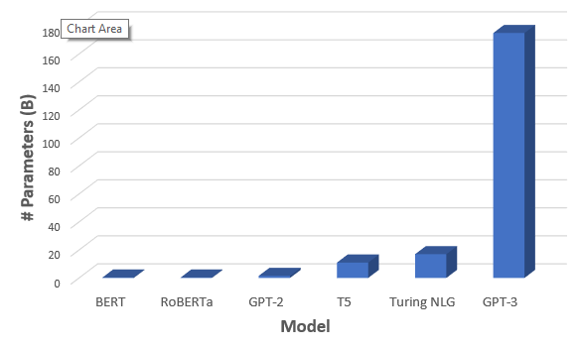
Neural Language Model
BERT (ELMO)
Contextualized word embedding
Also a language model
GPT-3
A more general language model
Both using transformer neural models
Trained on lots and lots of data

